Slide 1

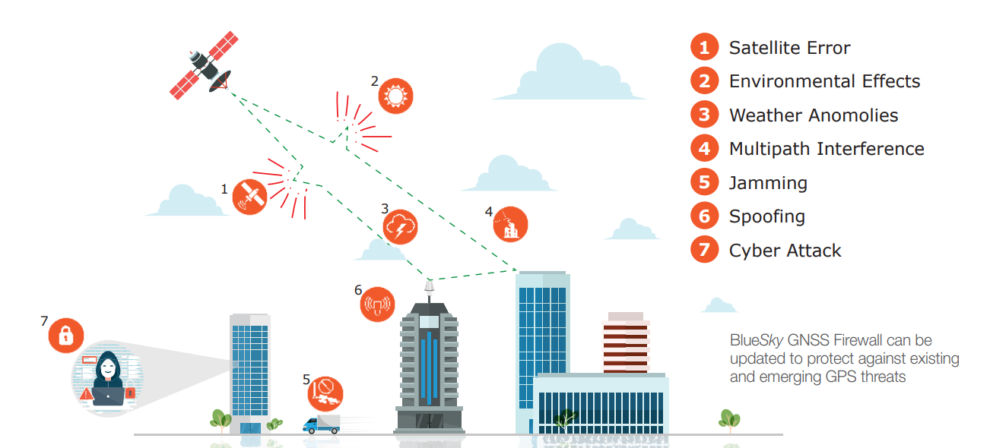
Causes of GNSS Anomalies
DID YOU KNOW: The power received on Earth from a GPS satellite, at -160 dBW, is equivalent to the strength of a flashlight in Los Angeles when observed from New York City, approximately 5000 kilometers.
Notes:
Title page with bold impactful images and fun type treatments.

Slide 2
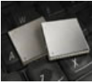
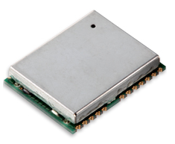
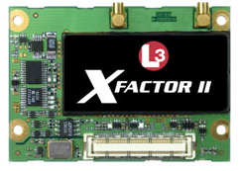

Current GPS Receivers
Civilian GPS receiver
  Commercial GPS receivers utilize L1 signal for tracking
  Varying levels of multi-constellation support and limited security features
  Civilian GPS receivers make-up most GPS receivers used by Critical Infrastructure
Military GPS receiver
  Selective Availability Anti-Spoofing Module (SAASM) receivers utilize L1 and the encrypted L2 signal for GPS tracking
  Provide better anti-jam performance and better protection against more advanced GPS attacks
  Not available for commercial applications
Notes:
This slide with the white bar works well diagrams with small type (or if it’s a jpeg with a white bkg).

Slide 3
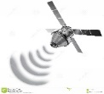
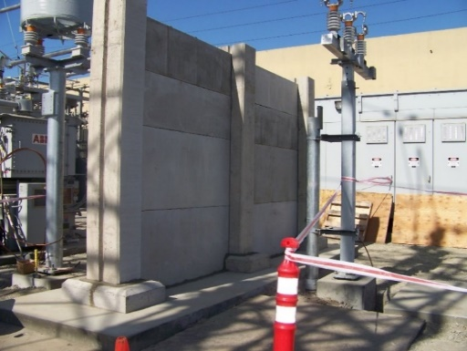
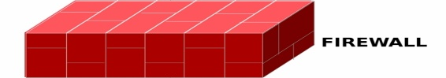
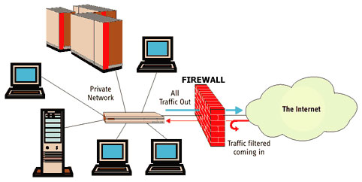
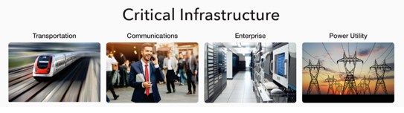
Firewall Concept
Physical Firewall at Electrical Substation
Unprotected PNT from the Sky
Secure PNT for Critical Infrastructure
Network Firewall
Notes:
Simple Diagram Slide
This was provided as a PPT Diagram, so it was easy to adjust the colors.

Slide 4


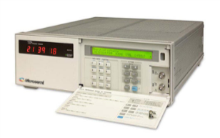
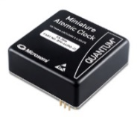
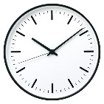
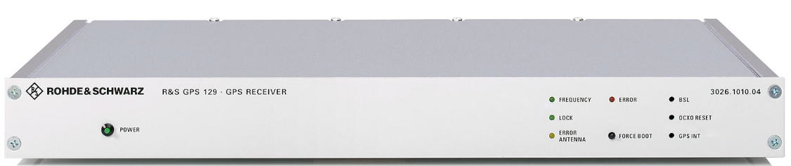
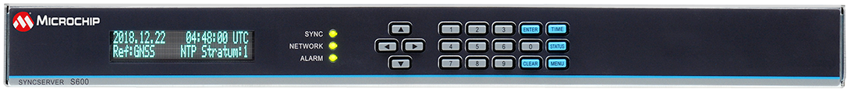
Support for Galileo
Live Sky
and
or
Reception/Anomaly
Detection
Optional
(inside)
or
Hardened
Output (GPS format)
Validated
Output (all bands)
GPS
TIME
GALILEO
TIME
Holdover
Notes:
We may also get block diagrams as a jpeg with a white background, and with the wrong colors.
If we have time to recreate them - great. If not because of the deadline, I wouldn’t worry about it.
If they know they want it recreated upfront (maybe because of changes to it for instance),
please check with the Creative Project Manager to have it put into the queue as a separate project.

Slide 5
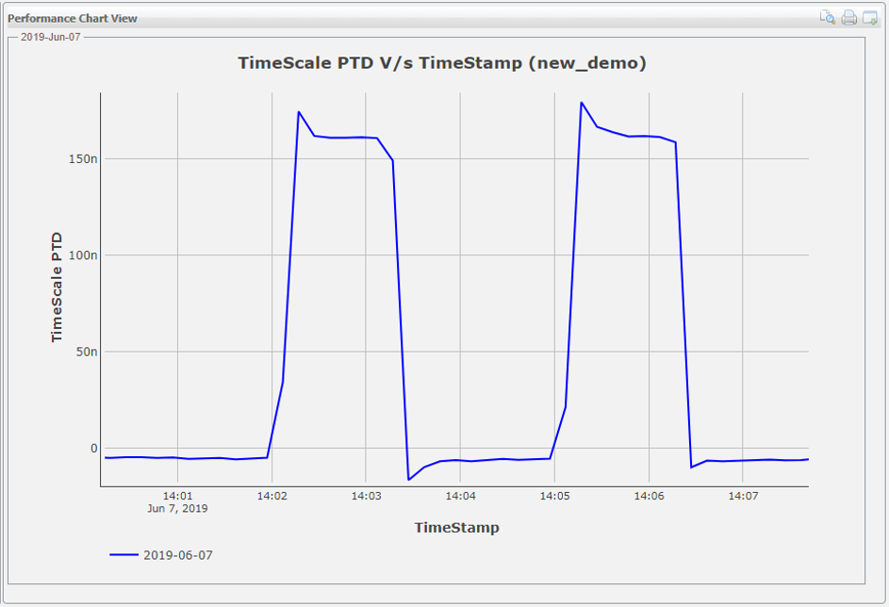
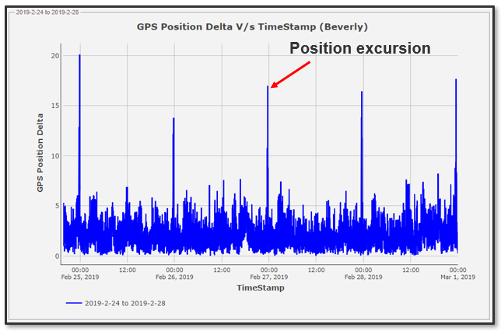
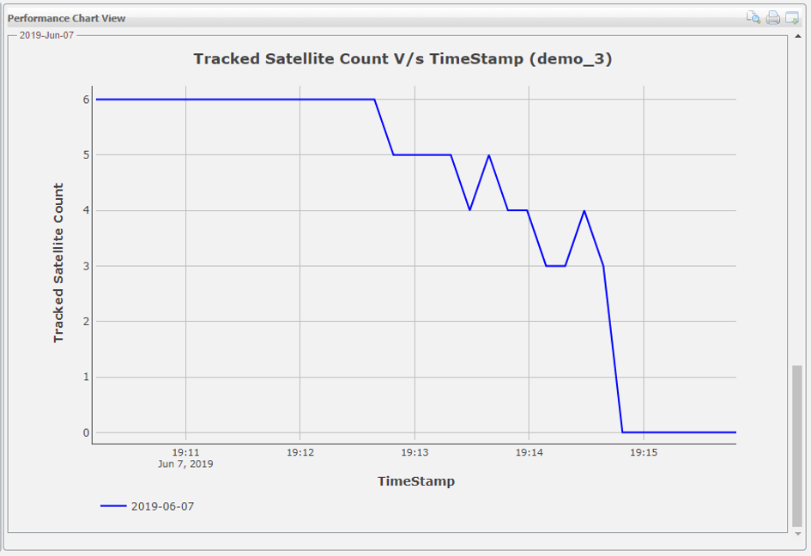
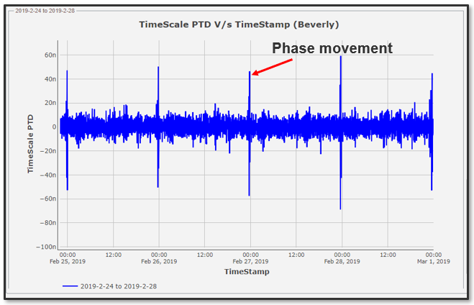
BlueSky™ Performance Monitoring
Timing
Anomaly
Phase Movement & Position Excursion
Spoof – Satellite Falling Out of View
Notes:
You can mix in the light blue hex background too.

Slide 6
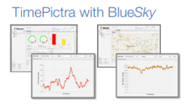

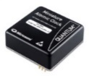
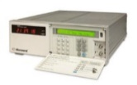
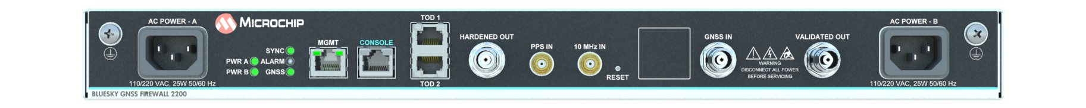
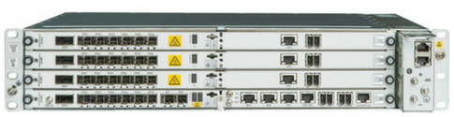
BlueSky™ GNSS Firewall Deployment Models
Firewall using
Validated Output
Firewall using
Hardened Output
Firewall Deployed for Monitoring Only
GPS Splitter
Optional
Cesium
Optional MAC
Hardened
Validated
SyncServer S600/S650
Equipment requiring GPS/L1 signal
Equipment requiring GPS/L1 signal
Notes:
This slide with the white bar works well diagrams with small type (or if it’s a jpeg with a white bkg).

Slide 7
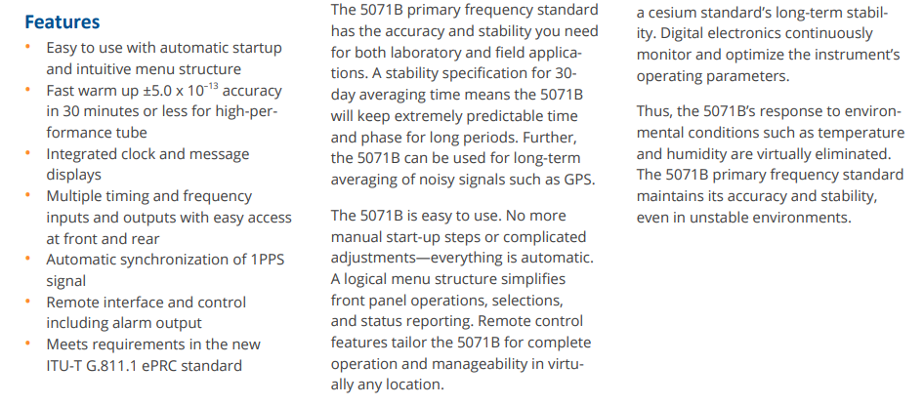
Performance Characteristics of High Performance 5071B
±5E-13 frequency accuracy for 5-year operating life
30 minutes to achieve ±5E-13 accuracy from power application
Environmental stability of ±8E-14
Allan deviation of 8.5E-13 τ-1/2 (τ ≥ 100 s) (HP)
Flicker floor 1E-14 (5E-15 typ)
MTBF 160,000 Hours
Field-replaceable beam tube
3U 19-inch rackmount chassis
Notes:
Simple Bulleted Page (with the visual weight of the text centered)
You can do an animation between each bullet if you want for emphasis.

Slide 8
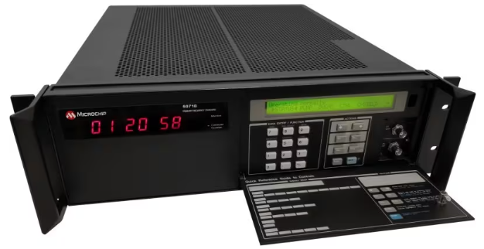
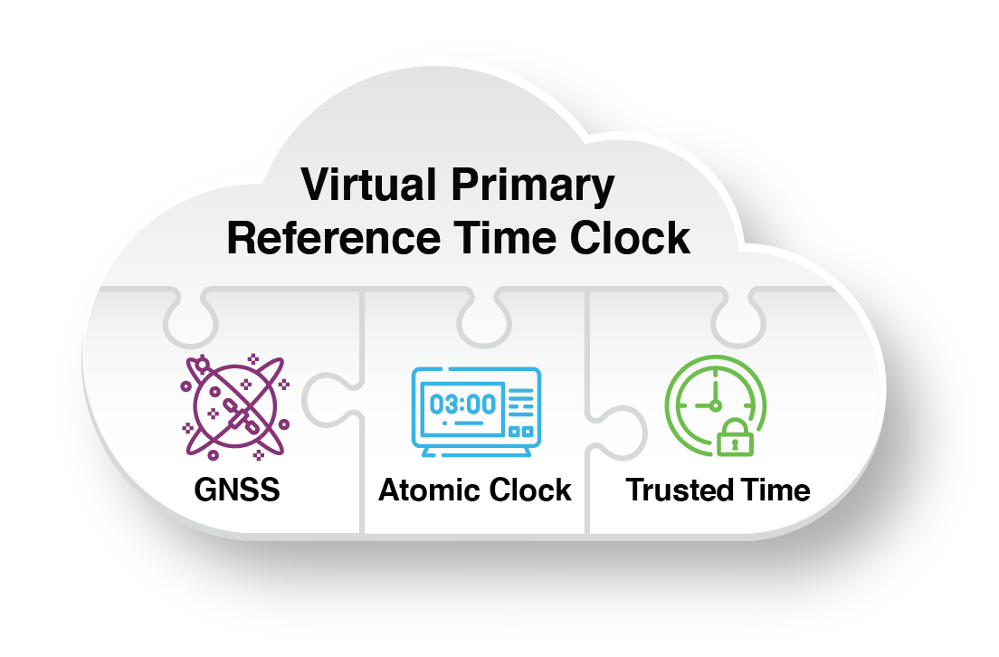
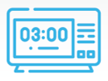
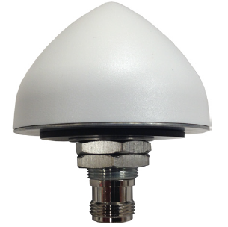
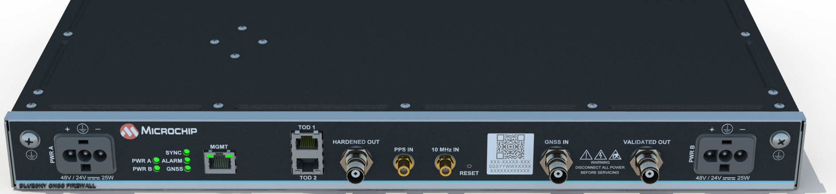



TimeProvider 4100 + ePRTC + BlueSky™
GNSS (live sky)
Provides Security, Protection, Visibility
10MHz
Provides Accuracy, Stability, Resiliency
5MHz
or
10MHz
Validated GNSS
(passed BlueSky™ detection)
Trusted Time™
PTP East
PTP West
Notes:
We may also get block diagrams as a jpeg with a white background, and with the wrong colors.
If we have time to recreate them - great. If not because of the deadline, I wouldn’t worry about it.
If they know they want it recreated upfront (maybe because of changes to it for instance),
please check with the Creative Project Manager to have it put into the queue as a separate project.

Slide 9
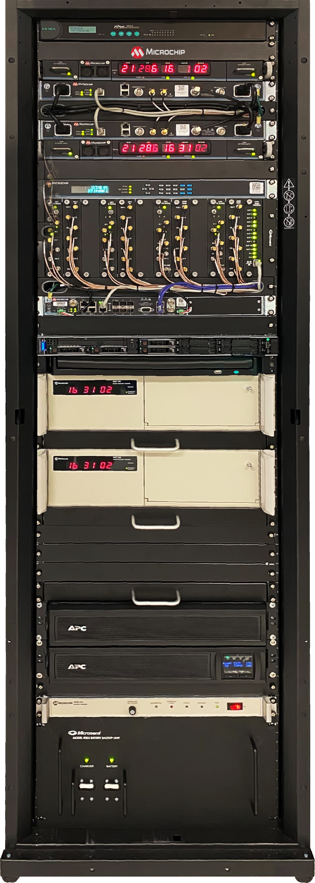
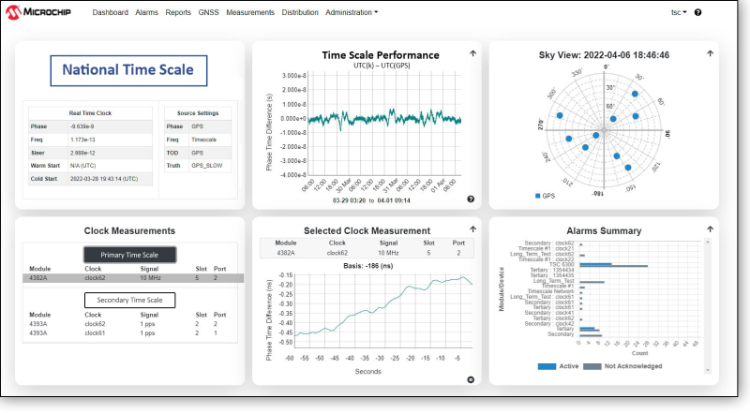
Precise Time Scale System
Serial to Ethernet Converter
GNSS Firewall (Primary)
SyncSystem 4380A Time Scale Edition (Primary)
GNSS Firewall (Secondary)
SyncSystem 4380A Time Scale Edition (Secondary)
SyncServer 650i
6300 Distribution Chassis
Time Provider TP 4100
Keyboard, Video monitor, Mouse – (KVM)
Time Scale Orchestrator
Dell PowerEdge R640
5071A Cesium clock
5071A Cesium clock
Tray/Space for additional
5071A Cesium Clock
APC UPS external battery pack
APC Smart Uninterrupted Power Supply (UPS) AC power backup
TSC 4022 Battery Charger
24V Battery Pack – DC power backup
Notes:
You can mix in the light blue hex background too.

Slide 10
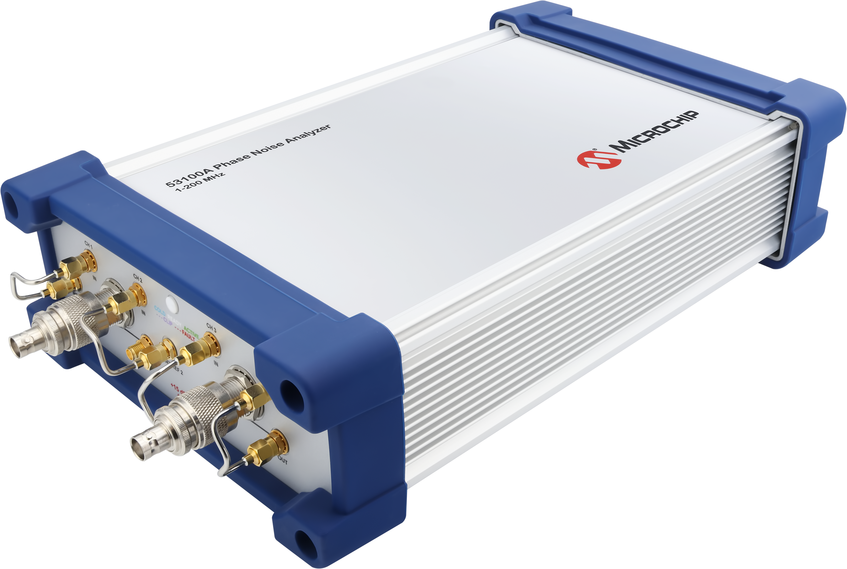
53100A Phase Noise Analyzer
Measures stability / accuracy of RF signals
  Quartz Oscillators and Atomic Clocks
Supports many simultaneous measurements
  Frequency Accuracy / counter, AM / phase noise, jitter, MTIE, ADEV, etc
Easy to use, yet capable of advanced measurements
  No calibration and rapid (one-click) acquisition
  Measure any frequency with a single reference oscillator
Direct-Digital Test Set using Cross-Correlation
Notes:
Image and bulleted text.
This one has a glow behind the board to help it pop.

Slide 11
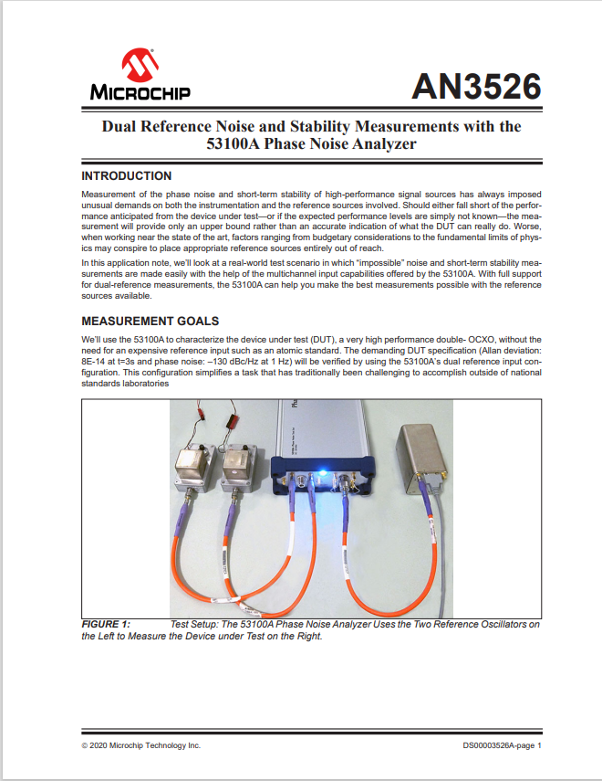
53100A: The Power of Cross-Correlation
Measure devices with superior noise compared to the reference oscillator!
Dual reference oscillators can achieve the noise floor limits of the instrument
How?
  Independent phase-difference measurements
  Cross-spectrum is calculated using Discrete Fourier transforms from the two channels to estimate noise of the input devices while rejecting noise of the measurement sub-systems
Notes:
This slide with the white bar works well diagrams with small type (or if it’s a jpeg with a white bkg).

